Slide 1
Chemometrics - formulas and tests, 1st part
Probability density function (PDF): expectation, mean, variance, skewness, kurtosis, entropy 2
(Non central) moment-generating function (MGF), covariance 3
Confidence interval for a single mean- frequentist approach 4
Confidence interval for the difference between means – frequentist approach 5
Credible interval for the mean – Bayesian approach 6
Hypothesis testing: single mean, difference between two means 7
Hypothesis testing: single variance, difference between two variances 8
Two one-sided t-test (TOST) for equivalence testing 9
Outliers – parametric tests 10
Outliers – non parametric tests 11
Multiple comparison between variances – parametric/non parametric tests 12
One-way ANOVA 13
Multiple comparison between means – parametric tests 16
Multiple comparison between means – non parametric tests: Kruskal-Wallis test e Dunn test 17

Slide 2
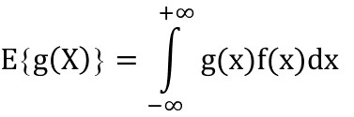

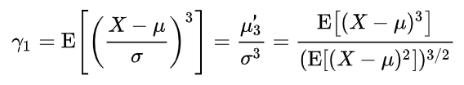
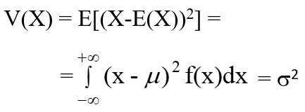
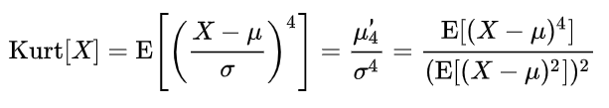


Probability density function (PDF): expectation, mean, variance, skewness, kurtosis, entropy
Expectation
Skewness
μ₃’ = E[(X-μ)³]
Standardized skewness (asymmetry coefficient)
Mean
(Standardized) kurtosis
Variance
(central moment of order 2)
Entropy
V(ax + b) = a² V(x)

Slide 3


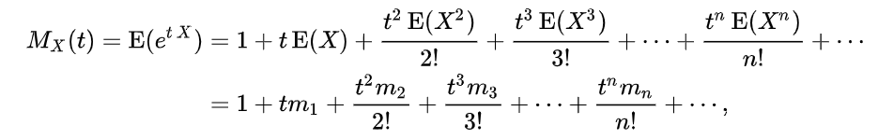

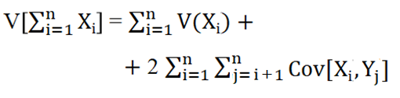
(Non central) moment-generating function, covariance
(Non central) moment-generating function (MGF)
Covariance
cov[X,Y] = E[(X- μ_{X})(Y- μ_{y})]
cov[X,Y] = E(XY) – μ_{x}μ_{y} =
= E(XY) – E(X)E(Y)
V[X+Y] = V(X) + V(Y) +
2 Cov (X,Y)
[dM_{X}(t)/dt]_{t=0} = E(X) = m₁ = μ
[d²M_{X}(t)/dt²]_{t=0} = E(X²) = m₂
…………………………………………………………….
[d^{n}M_{X}(t)/dt^{n}]_{t=0} = E(X^{n}) = m_{n}

Slide 4
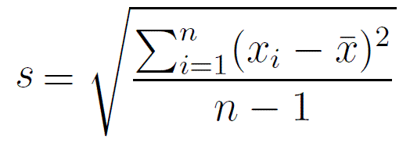
Confidence interval for a single mean - frequentist approach
First case: population variance, σ², known
- ≤ μ ≤ +
Second case: population variance, σ², unknown, n > 30
- ≤ μ ≤ +
Third case: population variance, σ², unknown, n < 30
- ≤ μ ≤ +

Slide 5
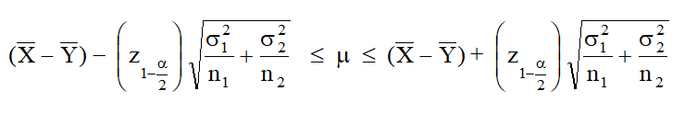
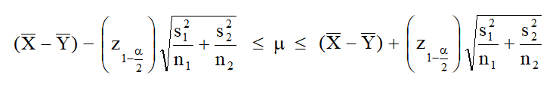
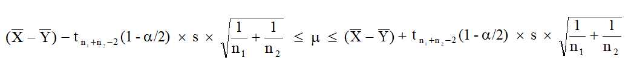
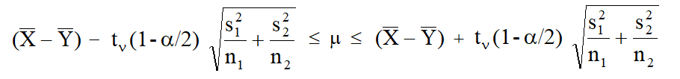
Confidence interval for the difference between means – frequentist approach
First case: population variances, σ₁² and σ₂² , known
Second case: population variances, σ₁² and σ₂² , unknown, n₁ and n₂ > 30
Third case: population variances, σ₁² and σ₂² , unknown but equal
Fourth case: population variances, σ₁² and σ₂² , unknown and different (Fisher-Behrens problem)
5

Slide 6

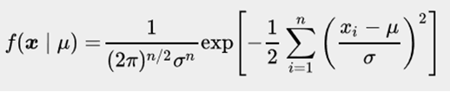

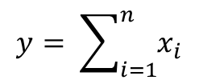
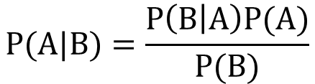
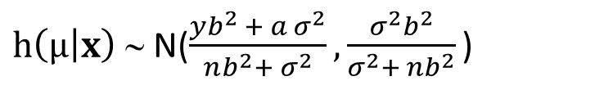
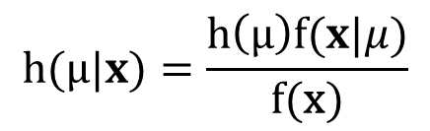
Credible interval for a mean - Bayesian approach
General posterior probability density function for mean μ
$$h(\text{μ}|x)=\frac{h\left(μ\right)f(x|μ)}{\text{f}\text{(}\text{x}\text{)}}$$
$$P(A|B)=\frac{P\left(B | A\right)P(A)}{P(B)}$$
Bayes’ theorem
Prior probability density function for mean μ
Conditional probability density function for the x set of data
Posterior probability density function for mean μ
$h\left(\text{μ} | x\right) $ N($\frac{yb^{2 }+ a σ^{2}}{nb^{2}+ σ^{2}},\frac{σ^{2}b^{2}}{σ^{2}+ nb^{2}}\text{)}$
$$y= \sum_{i=1}^{n}{x_{i}}$$
Special case: b = σ

Slide 7
Hypothesis testing: single mean, difference between two means
Comparison of a mean with a known value
Comparison between two means

Slide 8
Hypothesis testing: single variance, difference between two variances
Comparison of a variance with a known value
Comparison between two variances
Note that s²_{num} and s²_{den} are chosen so that s²_{num} > s²_{den}

Slide 9

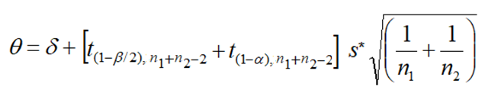

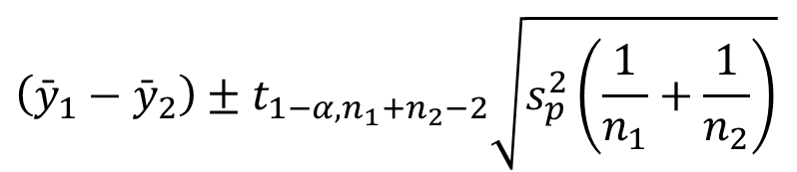
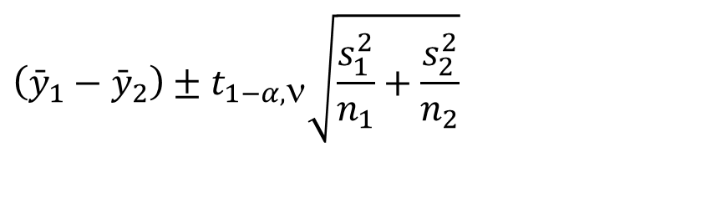
Two one-sided t-test (TOST) for equivalence testing
not equivalent
equivalent
Confidence intervals (significance level = 2α) to be compared with –θ/θ limits
$$\left({\bar{y}}_{1}−{\bar{y}}_{2}\right)±t_{1−α,n_{1}+n_{2}−2}\sqrt{s_{p}^{2}\left(\frac{1}{n_{1}}+\frac{1}{n_{2}}\right)}$$
Case 3
$$\left({\bar{y}}_{1}−{\bar{y}}_{2}\right)±t_{1−α,\text{n}}\sqrt{\frac{s_{1}^{2}}{n_{1}}+\frac{s_{2}^{2}}{n_{2}}}$$
Case 4
Evaluation of θ as a function of δ, α, β, s*, n₁, n₂ (case 3)

Slide 10






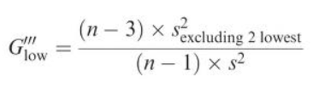

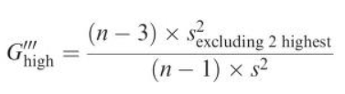

Outliers – parametric tests
Dixon’s Q test - statistics
Grubbs’ test for one outlier
single outlier (left tail)
single outlier on the left tail
single outlier on the right tail
one outlier on the evaluated tail,
one on the other tail
Grubbs’ test for two outliers
one outlier on the evaluated tail, two on the other tail
one outlier on each tail
two outliers on the evaluated tail, none on the other tail
two outliers on the left tail
two outliers on the evaluated tail, one on the other tail
two outliers on the evaluated tail, two on the other tail
two outliers on the right tail

Slide 11


Outliers – non parametric tests
Tukey’s Box-and-Whisker plot with box length = inter-quartile range (IQR = Q3 – Q1)
Median Absolute Deviation (MAD)
reject criterion
|X_{susp outl.} – Median(X)| / MAD > 5
lower and upper adjacent values usually represent values located at Q1 – 1.5 IQR and Q3 + 1.5 IQR, respectively

Slide 12

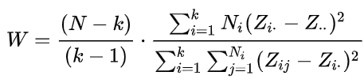

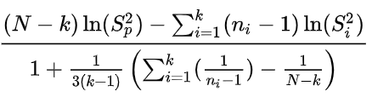





Multiple comparison between variances parametric tests
Multiple comparison between variances non-parametric test
Hartley’s (F-max) test - statistic
Levene’s test – statistic (k variances)
∼
F_{k-1,N-k}
Bartlett’s test – statistic (k variances)
T =
∼

Slide 13
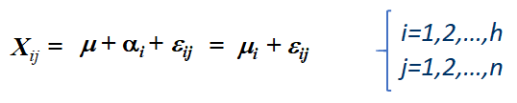
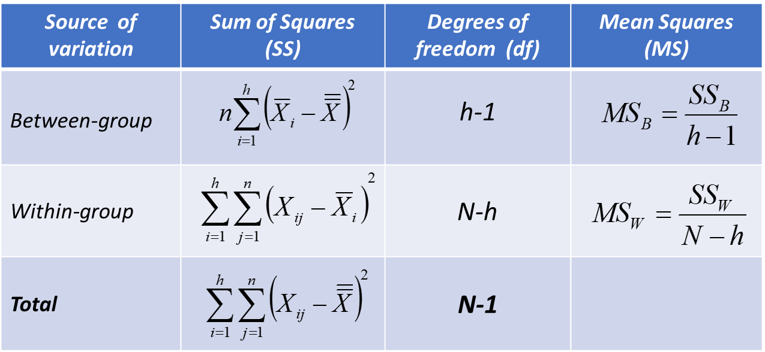
One-way ANOVA
Fixed effects ANOVA model
Partitioning of the total variability – first version
Formulations of hypothesis tests
SS_{tot} = SS_{between} + SS_{within}
H₀ : μ₁ = μ₂ =…… = μ_{i} = … = μ_{h} = μ
SS_{tot} = SS_{treatment} + SS_{error}
H₁ : H₀ is not true for at least one couple of values
ANOVA table – first version
H₀ : α₁ = α ₂ =…… = α _{i} = … = α _{h} = 0
H₁ : α_{i} ≠ 0 for at least one i
H₀ : X_{ij} = µ + ε_{ij}
H₁ : X_{ij} = μ_{i} + ε_{ij}
for at least one i

Slide 14
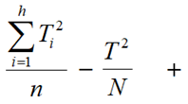
One-way ANOVA
Partitioning of the total variability – alternative version
=
SS_{tot} = SS_{between} + SS_{within}
SS_{tot} = SS_{treatment} + SS_{error}
ANOVA Table – alternative version
Statistic
∼ F_{h-1, N-h}

Slide 15


One-way ANOVA
Random effects ANOVA model
X_{ij} = μ + α_{i} + ε_{ij}
Formulation of hypothesis test
H₀: σ_{α}² = 0
H₁: σ_{α}² > 0
Expectations of Mean Squares
Statistic
E(MS_{Treatments}) = σ ² + n σ_{α}²
E(MS_{Error}) = σ ²

Slide 16
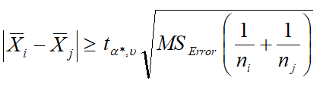
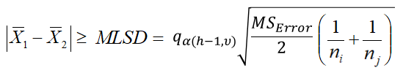

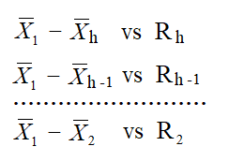
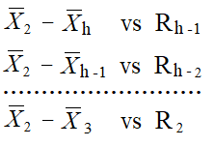


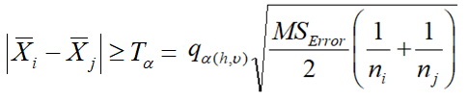

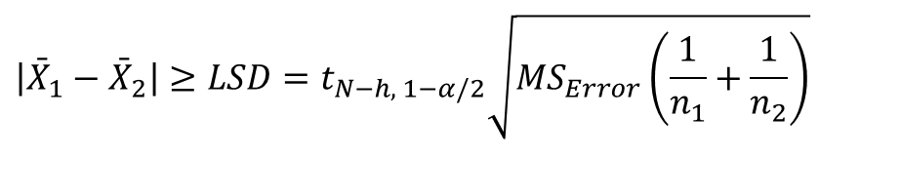
Multiple comparison between means - parametric tests
Fisher Least Significant Difference (LSD) test
Bonferroni test
α* = α/2c
$$\left|{\bar{X}}_{1}−{\bar{X}}_{2}\right|≥LSD=t_{N−h, 1−α/2}\sqrt{MS_{Error}\left(\frac{1}{n_{1}}+\frac{1}{n_{2}}\right)}$$
c = number of
comparisons
Duncan’s multiple range test
Fisher-Hayter Modified Least Significant Difference (MLSD) test
for p = 2,3,……,h
means arranged in decreasing order
Tukey’s test (equal size groups)
Tukey-Kramer’s test (unequal size groups)
Dunnett’s test (comparison of the i-th mean with control a)

Slide 17
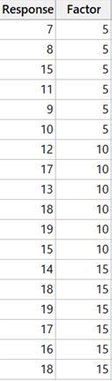



Multiple comparison between means - non parametric tests: Kruskal-Wallis test
Statistic for the comparison of g means
Example
7 ⇨ r₁₁ = 1
8 ⇨ r₁₂ = 2
9 ⇨ r₁₅ = 3
10 ⇨ r₁₆ = 4
11 ⇨ r₁₄ = 5
12 ⇨ r₂₁ = 6
13 ⇨ r₂₃ = 7
14 ⇨ r₃₁ = 8
15 ⇨ r₁₃ = 9
15 ⇨ r₂₆ = 10
16 ⇨ r₃₅ = 11
17 ⇨ r₂₂ = 12
17 ⇨ r₃₄ = 13
18 ⇨ r₂₄ = 14
18 ⇨ r₃₂ = 15
18 ⇨ r₃₆ = 16
19 ⇨ r₂₅ = 17
19 ⇨ r₃₃ = 18
∼ χ²_{g-1}
r₁ = 4
n_{i} = number of observations in group i
r_{ij} = rank (considering all observations) of observation j from group i
N = total number of observations
r₂ = 11
r = 9.5
r₃ = 13.5
Note: values of χ² distribution can be used with good approximation for N > 15.
Further critical values for the H statistic can be found on the following website:
https://www.dataanalytics.org.uk/critical-values-for-the-kruskal-wallis-test/

Slide 18
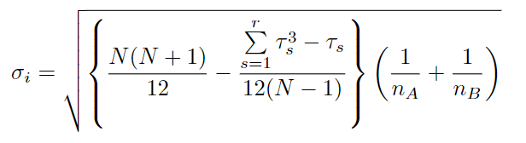
Multiple comparison between means - non parametric tests: Dunn test
z_{i} = y_{i} / σ_{i}
where:
i is one of the 1 to m comparisons
y_{i} = r_{A} – r_{B} is the difference between the average ranks of groups A and B under test
where τ_{s} represents the number of ties in the s^{th} group of ties (if no ties are present, the sum shown in the formula is equal to 0).
Each z_{i} value has to be compared with a critical value related to the standard normal distribution, depending on the significativity value α.

